Slide 1
Business Analytics: Advance
Basics of Data (I)

Slide 2
Recap
What is Business Analytics?
The maturity stages of Business Analytics
Brief introduction about Data science, AI, Machine learning, IOT and Big Data – Hadoop!
Importance of Data Visualization
Latest technology trends

Slide 3
Outline of the Supervised Learning Program
Day | Topics (Professionals)
1 | Introduction to Analytics and its Applications
2 | Basics of Data/Statistics/R (Analytical tool) - I
3 | Basics of Data/Statistics/R/Alteryx Demo(Analytical tool) - II
4 | Linear Regression
5 | Logistic Regression
6 | Clustering
7 | Decision Tree
8 | Time series Modelling
9 | Practical Session on Use cases
10 | Market Basket Analysis
11 | Text Mining
12 | Data Visualization
Plan
Program Duration: 3 months
On Every Saturday & Sunday from 10 am to 1 pm IST
8 Weeks of support after the completion of the program (12 hrs, based on pre-booked appointment)
Change in dates will be notified in advance as needed

Slide 4
Outline
Significance of Data
Analyzing Data
Identify Types of Data Variables
Summarizing data
Identify Measures of central tendency
Describe Measures of spread
Identify Skewness of data distribution
Data Collection and Management Framework
Data Collection
Data Dictionary
Outlier Treatment
Missing Value Imputation

Slide 5
Agenda
Importance of Data
Analyzing Data
Data Collection and Management

Slide 6
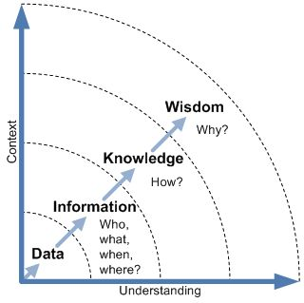
Data & it’s importance
Data is any set of characters that has been gathered and translated for some purpose, usually analysis. It can be any character, including text and numbers, pictures, sound, or video.
Data is simply another word for information.
Data helps in making better decisions at business as well as operational level and saves time.
Some interesting Facts about data !
Every two days we create as much data as we did from the beginning of time until 2003.
If you burned all of the data created in one day onto DVDs, you could stack them on top of each other and reach the moon twice.

Slide 7
Population vs. Sample
Population
Not to be confused with literal meaning of "population" which means number of people living in a defined geographical region.
The "population" in statistics includes all members of a defined group that we are studying or collecting information on for data driven decisions.
Example:
Sample
It is a part of the "population".
Can be biased or un-biased (also know as random sample).
Example: (Component reliability )
Current inflation rates of EU countries having per capita income of less than 20000 Euros per annum.
A portion of votes collected to predict the election outcome through "Exit Poll".
Population
Sample1
Sample2
Sample3
Notes:
http://www.dissertation-statistics.com/population-sample.html

Slide 8
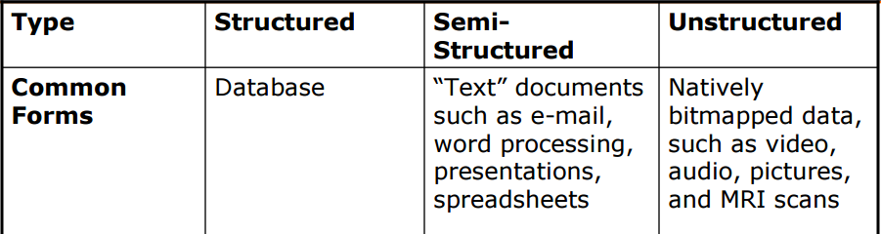
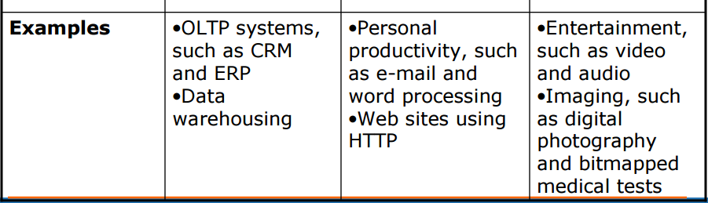
Structured, Semi-Structured and Unstructured Data
Structured Data :- It concerns all data which can be stored in database SQL in table with rows and columns. They have relational key and can be easily mapped into pre-designed fields.
Semi-Structured Data :- Semi-structured data is information that doesn’t reside in a relational database but that does have some organizational properties that make it easier to analyse. With some process you can store them in relation database.
Unstructured Data :- Unstructured data represent around 80% of data. It often include text and multimedia content.

Slide 9
Identify Data Types

Slide 10
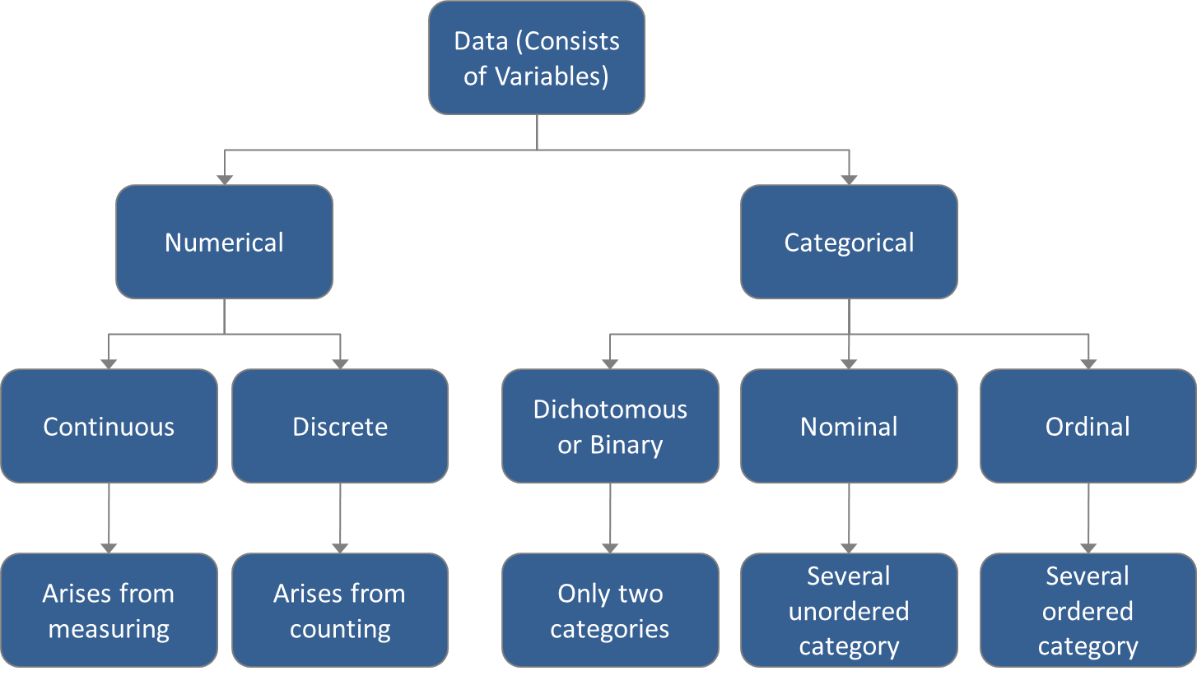
Data types (I)

Slide 11
Data types (II)
Data consists of a combination of "variables" which actually contain the values
Variables at a high level are of two types depending on the kind of values they store:
Numerical
Categorical
Numerical variables
Discrete
Arises from counting
can take only a set of particular values including negative values
Examples: Credit score, number of credit cards owned by a person, number of states in a country, charge on electron etc.
Continuous
Arises from measuring
Can take any value within a specified range
Examples: Height, Amount of money, Age etc.
Categorical variables
Binary (or Dichotomous)
Has only two categories
Examples: yes/no, male/female, pass/fail etc.
Nominal
Has several unordered category
Examples: Type of bank account, type of insurance policy etc.
Ordinal
Has several ordered category
Examples: questionnaire responses such as "strongly in favour / … / strongly against".

Slide 12
Types of Data variables (Data snapshot)
Sl # | Name of Manufacturer | Manufacturer ID | Number of Equipment's | Annual Equipment Failures | Manufacturer Type | Manufacturer Category | Annualized Maintenance cost | Failure Rate
1 | Josh | 111669 | 5 | 42 | LOCAL | Medium | 88,001 | Low
2 | Janice | 146861 | 6 | 25 | LOCAL | Large | 592,489 | Low
3 | Dandre | 171690 | 3 | 50 | IMPORTED | Small | 272,304 | Low
4 | Aiden | 161721 | 6 | 37 | IMPORTED | Large | 726,593 | Low
5 | Celine | 170359 | 7 | 50 | LOCAL | Medium | 612,075 | Low
6 | Emilio | 175646 | 5 | 41 | IMPORTED | Medium | 490,356 | Low
7 | Joaquin | 180732 | 2 | 62 | LOCAL | Small | 164,732 | Low
8 | Justus | 113136 | 7 | 26 | LOCAL | Medium | 510,321 | Low
9 | Chaya | 169254 | 4 | 24 | IMPORTED | Medium | 358,534 | Low
10 | Justyn | 149771 | 4 | 35 | IMPORTED | Large | 140,400 | Low
11 | Jadon | 166226 | 7 | 36 | IMPORTED | Medium | 105,259 | Low

Slide 13
Types of Data variables
Variable Name | Name of Manufacturer | Manufacturer ID | Number of Equipment's | Annual Equipment Failures | Manufacturer Type | Manufacturer Category | Annualized Maintenance cost | Failure Rate
Value Stored | Name of the individual manufacturer | Unique identifier | 1, 2, 3… | 18, 19, 20… | Local/Imported | Small / Medium / Large | Amount | Low(<25%) / Medium(<50%) / High(<75%) / Very High(>75%)
Variable Type | ? | ? | ? | ? | ? | ? | ? | ?
Remarks

Slide 14
Case: Types of Data variables (Revisited)
Variable Name | Name of Manufacturer | Manufacturer ID | Number of Equipment's | Annual Equipment Failures | Manufacturer Type | Manufacturer Category | Annualized Maintenance cost | Failure Rate
Value Stored | Name of the individual manufacturer | Unique identifier | 1, 2, 3… | 18, 19, 20… | Domestic / International | Mass Production/ Batch Production/ Job Shop/ Projects | Amount | Low(<25%) / Medium(<50%) / High(<75%) / Very High(>75%)
Variable Type | -- | -- | Numerical (Discrete) | Numerical (Discrete) | Categorical (Binary) | Categorical (Nominal) | Numerical (Continuous) | Categorical (Ordinal)
Remarks | Identifier | Identifier | Arises from counting. Takes certain discrete values in a given range | Arises from counting. Takes certain discrete values in a given range | Only two categories | Several ordered category | Takes many values in a given range | Several ordered category

Slide 15
Typical Data Analysis Approach
Identify Data Variable Types
Summarize Data
Analyze Data Central Tendency
Analyze Data Spread
Analyze Data Skewness

Slide 16
Summarize Data

Slide 17
Summarizing Data
There are various ways to summarize data. Some of them are
Frequency distribution
Grouped frequency distribution
Cumulative frequency distribution
Stem leaf diagram
Line plots
…

Slide 18
Summarizing Data - Frequency distribution
A technique to summarize discrete data
A simple process which involves counting of distinct discrete values
The representation can be either tabular or graphical
Example: Number of Failures out of total critical equipments
Tabular representation
No. of failures | No. of equipments
1 | 136
2 | 44
3 | 13
4 | 8
5 | 4
6 | 9
7 | 2
8 | 1
9 | 1
11 | 2
12 | 5
13 | 1
15 | 2
Graphical representation - Bar Chart

Slide 19
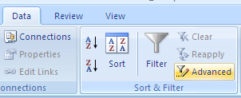
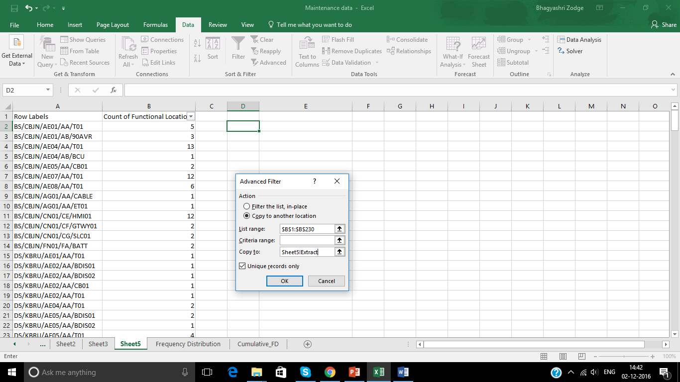
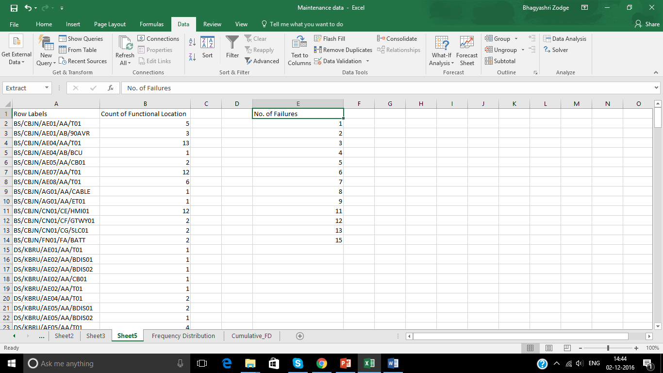
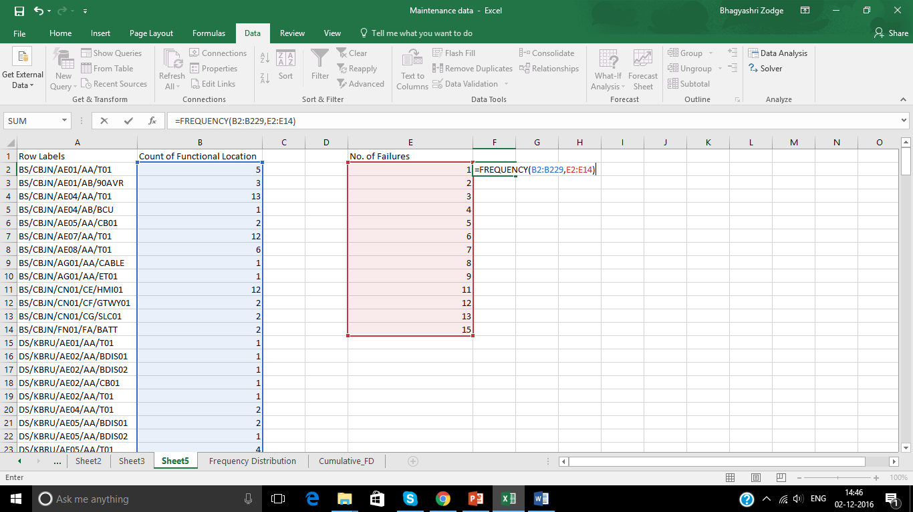
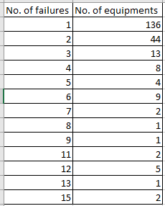
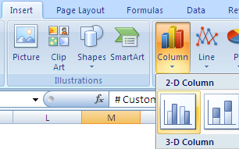
Summarizing Data-Frequency distribution
1
2
3
4
7
6
5

Slide 20
Summarizing Data - Grouped Frequency distribution
A technique to summarize continuous data or discrete data having large number of observations and an extended range
A simple process which involves counting of values falling under the different intervals (grouped)
Example and illustration 2.2: Number of customers falling under different Salary groups
Graphical representation - Bar Chart

Slide 21
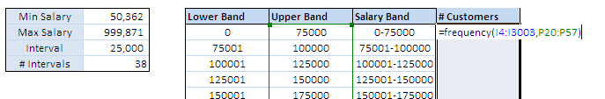
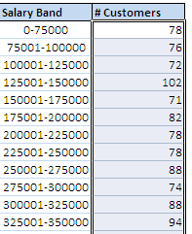
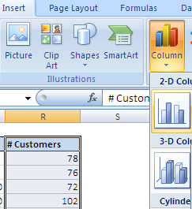
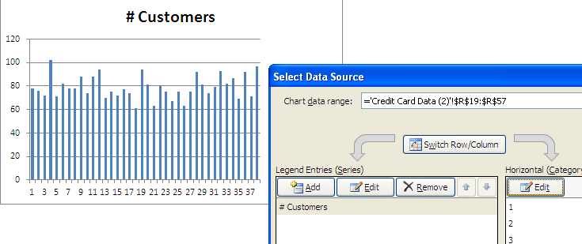
Summarizing Data – Grouped Frequency distribution
1
2
1. Press “ctrl+alt+enter”
5
5.Observe the difference between horizontal axes of two charts
4
3
4.From “Edit” select the salary bands as horizontal axis

Slide 22
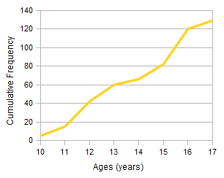
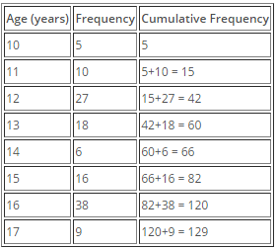
Summarizing Data - Cumulative Frequency distribution
Cumulative frequencies are obtained by accumulating the frequencies to give the total number of observations up to and including the value or group in question.
Example and illustration : Cumulative frequency of Age of students in a particular School.
Tabular representation
Graphical representation

Slide 23
Analyze Data Central Tendency

Slide 24
Measures of Central Tendency
Mean
Mode
Median
There are a number of different quantities, which can be used to estimate the central point of a sample.
These are called measures of central tendency, or measures of location.
Just different ways of calculating the "average" value of dataset

Slide 25
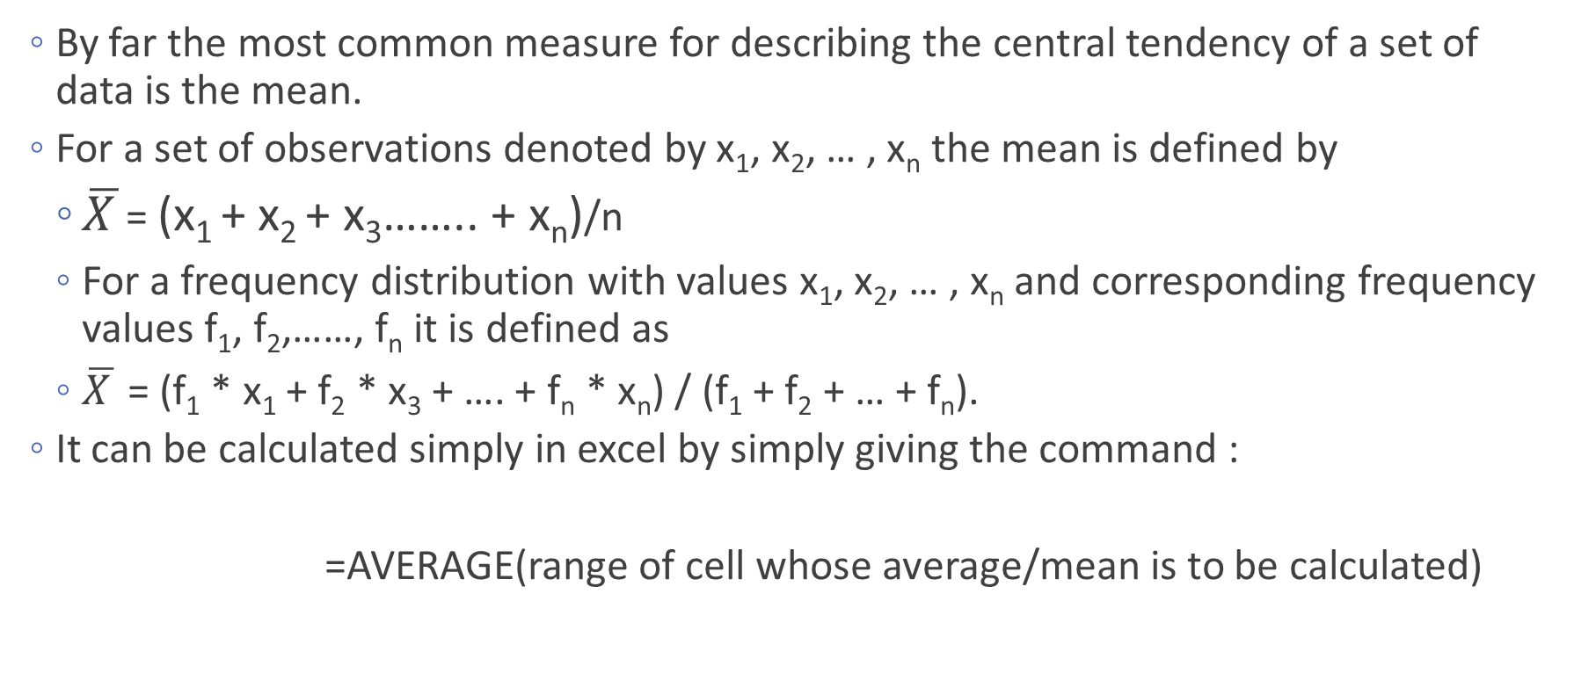
Mean- Measure of Central Tendency
By far the most common measure for describing the central tendency of a set of data is the mean.
For a set of observations denoted by x₁, x₂, … ,x_{n} the mean is defined by
$\overline{X }$= (x₁ + x₂ + x₃…….. + x_{n})/n
For a frequency distribution with values x₁, x₂, … ,x_{n} and corresponding frequency values f₁, f₂,……,f_{n} it is defined as
$\overline{X }$= (f₁ * x₁ + f₂ * x₃ + …. + f_{n} * x_{n}) / (f₁ + f₂ + … + f_{n}).
It can be calculated simply in excel by simply giving the command :
=AVERAGE(range of cell whose average/mean is to be calculated)

Slide 26
Median- Measure of Central Tendency
Another useful measure of central tendency.
The median is a value, which splits the data set into two equal halves.
So that half the observations are less than the median and half are greater than the median.
If n is odd, then the median is the middle observation.
If n is even, then the median is the midpoint of the middle two observations i.e. (n + 1) / 2th observation.
One of the potential advantages of the median for certain data sets is that it is robust or resistant to the effects of extreme observations.
It can be calculated in excel simply by giving command :
=MEDIAN(Range of cell whose median is to be calculated)

Slide 27
Mode- Measure of Central Tendency
A third measure of location is the mode.
Defined as the value which occurs with the greatest frequency or the most typical value.
Excel has inbuilt function “Mode” for granular data
For summarized data it can be find easily by visual inspection
Here, Mode = 1

Slide 28
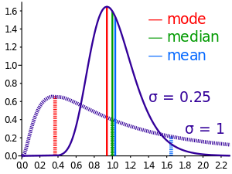
Significance of Mean, Median & Mode
MEAN: You wish to summarise data, taking every single data point into account; You wish to compare two (or more) groups in terms of average differences.
E.g.- Mean is used in any per-capita report.
MEDIAN: You wish to find out at what point the data is halved in terms of population; You want to find the middlemost data point.
E.g.- Used in reporting incomes. The median income in an area tells you more what the average person earns. A few astronomically high values, from CEOs, Bill Gates, etc. through the Mean off, so the Median is used.
MODE: You wish to find the most common data point; You want to find the data point with the highest tendency to arise; you wish to summarise non-numerical data.
E.g.- A retailer may want to know the sizes purchased of clothing for two stores to help them set stocking levels. Here, Mode is used. Store A has a mode of "Small", and Store B has a mode of "XXL".

Slide 29
Summary of when to use the mean, median and mode
Type of Variable | Best measure of central tendency
Nominal | Mode
Ordinal | Median
Interval/Ratio (not skewed) | Mean
Interval/Ratio (skewed) | Median

Slide 30
Analyze Data Spread

Slide 31
Measure of Spread
Variance
Range
Inter Quartile Range
Standard Deviation
The central tendency of a data set is usually the main feature of interest.
Another feature of interest is the spread (or variability or dispersion or scatter)
Meaning how widely spread the data are about the mean (or other measure of location).

Slide 32
Variance and Standard Deviation
Variance in Statistics is a way to measure how far a set of numbers is spread out. Variance describes how much a random variable differs from its expected value. The variance is defined as the average of the squares of the differences between the individual (observed) and the expected value
For a data set having values x1, x2,…,xn (or xi where i=1,2,…,n) and mean of <x> variance is calculated as
For granular data: Variance (σ²) = ∑(xi - <x>)²/n
For summarized frequency table: Variance (σ²) = ∑{fi*(xi - <x>)²}/n
Standard deviation is positive square root of variance denoted by σ
Sample Variance is the biased estimator of population. Dividing by (n-1) corrects the bias in the estimation of the population variance.
To calculate variance in excel : = VAR(Range of cell whose variance is to be calculated)
To calculate standard deviation in excel : =STDDEV(Range of cell whose std deviation is to be calculated)
If variance is high, that means you have larger variability in your dataset. In the other way, we can say more values are spread out around your mean value.
The larger the standard deviation, larger the variability of the data

Slide 33
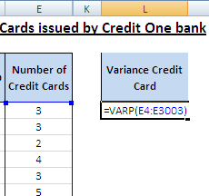
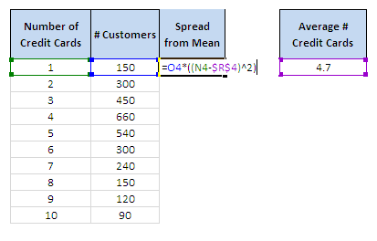

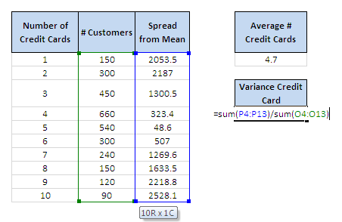

Variance and Standard Deviation
1. Using Excel function for granular data
2. For summarized data in form of frequency table
1
2

Slide 34
Range
The range is a very simple measure of spread defined, as its name suggests, by the difference between the largest and smallest observations in the data set.
Range = max(xi) – min(xi)
A poor measure of the spread of the data as it relies on the extreme values
Which aren't necessarily representative of the data as a whole.

Slide 35
Inter quartile Range
Similar to Range but is not affected by the data extremes.
Just as the median divides a set of data into two halves, the quartiles divide a set of data into four quarters. They are denoted by Q1, Q2 and Q3.
Q2 is just the median, while Q1 is called the lower quartile and Q3 the upper quartile.
Q1 can be defined to be the (n + 2) / 4th observation counting from below and Q3 as the same counting from above, with relevant interpolation if needed.
The Inter quartile range is defined as Q3 − Q1.
To calculate quartiles in Excel:
=QUARTILE.INC ( array, quart )
Five-number summary and boxplots
Min, Q1, Q2, Q3, Max

Slide 36
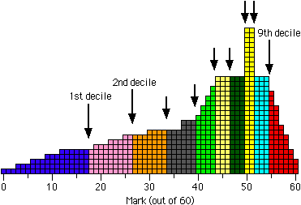
Percentile and Decile
Percentile: The nth percentile is the lowest score that is greater than a certain percentage (“n”) of the scores. Percentiles of a distribution are the 99 values that split the data set into a hundred equal parts. For example, the 65th percentile can be defined as the lowest score that is greater than 65% of the scores.
Number | Rank
3 5 7 8 9 11 13 15 | 1 2 3 4 5 6 7 8
The first step is to compute the rank (R) of the 65th percentile. This is done using the following formula:
R = P/100 x (N + 1)
where P is the desired percentile (25 in this case) and N is the number of numbers (8 in this case). Therefore,
R = 65/100 x (8 + 1) = 9/4 = 5.85.
Example: Common admission test (CAT) uses percentile as scores of the candidates.
Decile: In a similar way, the deciles of a distribution are the nine values that split the data set into ten equal parts.
For example, the histogram on the right shows the distribution of marks in a test (out of 60) that was attempted by 600 students. Each student's mark is represented by a square in the histogram.

Slide 37
Analyze Data Skewness

Slide 38
Symmetry and skewness
It deals with the shape of the distribution of a data set, that is, whether it is symmetric or skewed to one side or the other.
The approximate shape of a distribution can be determined by looking at a
Symmetrical:
Mean = Median = Mode
Positively Skewed:
Mean > Median > Mode
Negatively Skewed:
Mean < Median < Mode

Slide 39
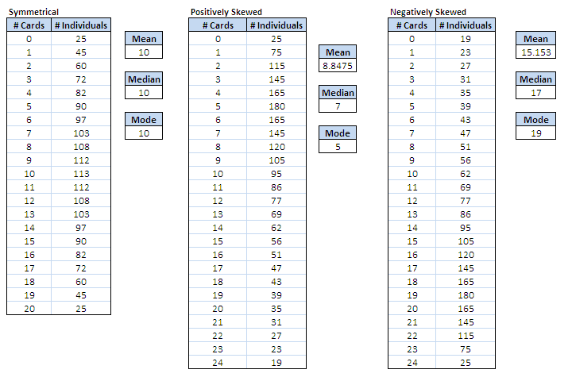
Skewness

Slide 40
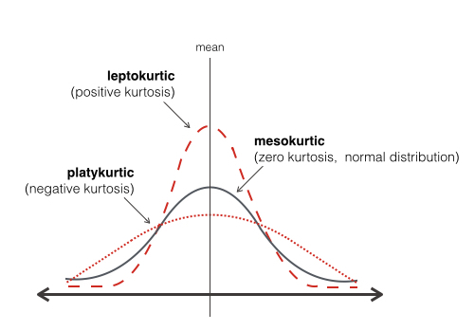
Kurtosis
Kurtosis is the measure of the peak of a distribution, and indicates how high the distribution is around the mean.
All three of these distributions have mean of 0, standard deviation of 1, and skewness of 0, and all are plotted on the same horizontal and vertical scale. Look at the progression from left to right, as kurtosis increases.

Slide 41
Data Collection and Management

Slide 42
Data Collection and Management Framework
At a high level, from an analyst's perspective data collection and management framework will involve following components
Data Collection Mechanism
Reformatting Data
Maintain a data directory/dictionary
Missing Value Imputation
Outlier treatment

Slide 43
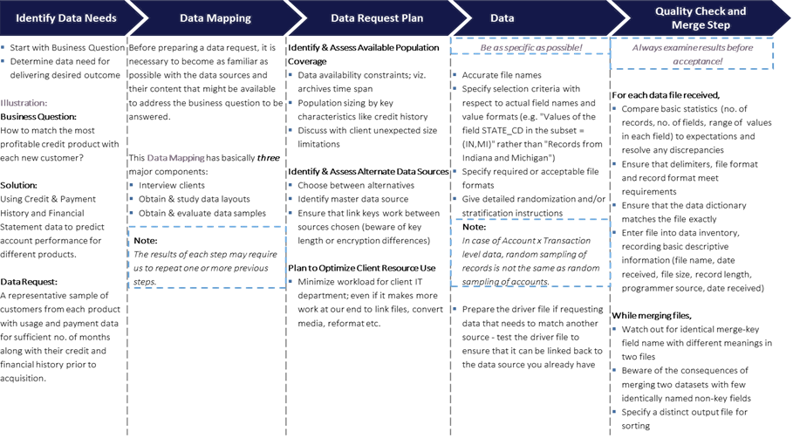
Data Collection - quick background
Prep.

Slide 44
Data Dictionary
A comprehensive data dictionary should be maintained and updated as and when any new information is gathered.
USE: It can go a long way in helping us understand the data better. For instance, it can help us to revisit old information and see what our initial hypothesis was and how it is changing with the new updated information.
Example of Data Dictionary:-
Maintain labels of as many variables as possible
If possible, one should also try to capture the business sense of these variables
Wherever things are not clear, it should be noted down so that it can be clarified with the client later on
Clear Definition of Unique Identifier and its Meaning:
Ascertain the level at which data is to be rolled up / down. For instance,
Individual level
Individual x Account level
Individual x Month level
Individual x Account x Month level, etc.
Identify unique key of every dataset. Few examples below:
Payment data may be at transaction level
Demographic data at individual level
Census data at zip code level
Dependent Variable Definition and Meaning: This is a very crucial step in modeling exercise as wrong definition can lead to completely wrong conclusions. In absence of a clear definition at this stage, it may be defined later after some actual data analysis.
Variable Classification:
Performance variables, e.g. spend, number of transactions
Credit Attributes, e.g. total credit line, FICO score
Census level, e.g. population, location attributes such as income levels
Maintain meaning of all Potential Predictors
Demographic variables, e.g. age, gender
Field Name | Data Type | Other Info
Customer ID | Numeric | Primary Key Field
Title | Text / Character | Lookup: Mr, Mrs, Miss, Ms Field size 4
FirstName | Text / Character | Field size 15
DateOfBirth | Date / Time | Format: Medium Date Range check: >= 01/01/1930

Slide 45
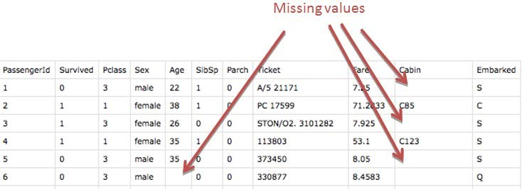
Missing Values
In Statistics, missing values occur when no data value is stored for the variable in an observation.
Missing Values might occur due to natural or non-natural reasons such as manual data entry procedures, equipment errors etc.
Effect of missing data
Bias
Power and Variability
Inaccurate results

Slide 46
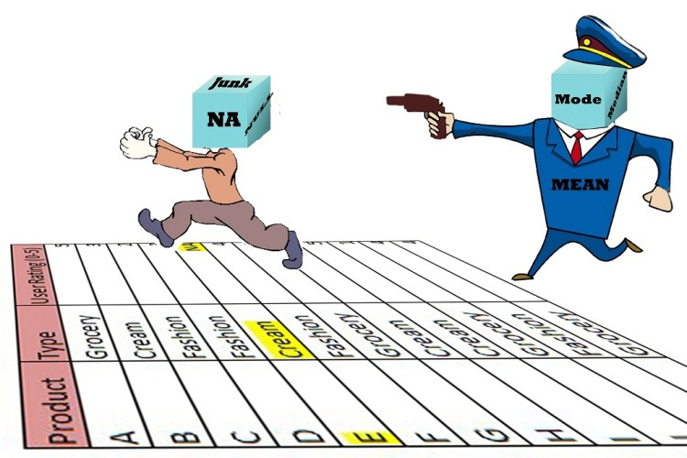
Missing Value Imputation
Missing Value Imputation Techniques
Impute Missing Values with ZERO
Impute Missing Values with MEDIAN
Impute Missing Values with MEAN
Impute Missing Values with MODE
Information based Segmentation
Non-Missing Dummy Creation
Imputation and Non-Missing Dummy Creation
Impute based on Bivariate Graphs
Impute using Regression on other Non-Missing Predictors
Multiple Imputation
Deletion of Record
There are a variety of techniques for missing value imputation; but these should be considered more as scenario-specific than just being a set of pure alternative choices.
Notes:
Ref http://www.analyticskhoj.com/wp-content/uploads/2015/12/Missing-Value-imputation-basic-way-750x500.jpg

Slide 47
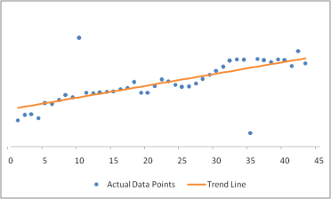
Outlier Treatment
An outlier is a single observation "far away" from rest of the data.
Reasons for outliers:
Errors
Data errors
Sampling error
Intentional errors
Natural errors
Human Error
Genuine Outliers
Why do we care about outliers?
Outliers are BAD
The presence of outliers can lead to inflated error rates and substantial distortions of results that can lead to wrong conclusions and inferences.
Outliers are GOOD
The outliers can provide useful information in the data, for example, a spike in spend behavior of some customers may prove to be the deciding factor in marketing response campaigns. So care should be taken while dealing with outliers.
In short, outliers are important and hence should not be ignored.
Outlier
Techniques for outlier detection / treatment:
Capping and Flooring Technique
Exponential Smoothing Technique
Sigma Approach
Robust Regression Technique
Mahalanobis Distance Technique
Outlier

Slide 48
Applications of Outlier detection
Fraud detection
Purchasing behavior of a credit card owner usually changes when the card is stolen
Abnormal buying patterns can characterize credit card abuse
Medicine
Unusual symptoms or test results may indicate potential health problems of a patient
Whether a particular test result is abnormal may depend on other characteristics of the patients (e.g. gender, age, …)
Public health
The occurrence of a particular disease, e.g. tetanus, scattered across various hospitals of a city indicate problems with the corresponding vaccination program in that city
Whether an occurrence is abnormal depends on different aspects like frequency, spatial correlation, etc.

Slide 49
Accomplishments today!
Importance of Data
Analyzing Data
Data Collection and Management

Slide 50
Thank You!

